Slide 1


ULwazi ngeeNdlela zokuThintela i-HIV

Slide 2

IiNdlela zokuThintela i-HIV
Zininzi izinto ongazenza ukunciphisa umngcipheko we-HIV wakho okanye oweqabane lakho.
Abacebisi bafuna ukukunceda uqonde zonke ezi ndlela zilandelayo zokuthintela i-HIV ukuze ukhethe ukuba yeyiphi i(ii)ndlela ezakusebenzela ngcono:

Slide 3

Uphando lubonise ukuba iringi efakwa ekukwini ye-dapivirine inganciphisa ithuba lowasetyhini kulosulelo lwe-HIV.
Ukhuseleko kulosulelo lwe-HIV luphezulu kakhulu xa iringi isetyenziswa ngalo lonke ixesha.
Sebenzisa iringi efakwa ekukwini
ye-dapivirine rhoqo

Slide 4
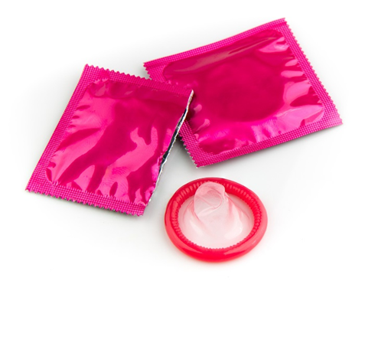
Sebenzisa iikhondom rhoqo
Sebenzisa ikhondom ngokuchanekileyo ngalo lonke ixesha usabelana ngesondo ngekuku, ngomngxuma welindle okanye nimuncana ilungu langasese.
Notes:
Jonga ngasemva kweli phetshana ukuze ufumane iinkcukacha ezithe vetshe ngeekhondom.

Slide 5
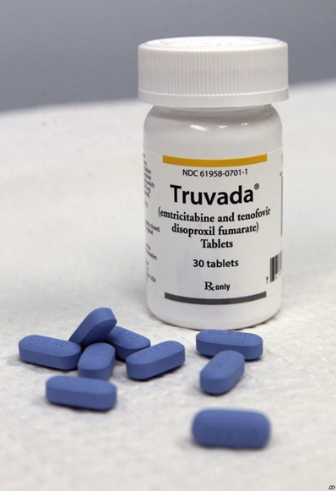

Sebenzisa i-PrEP eginywayo (umz. i-Truvada)
I-PrEP eginywayo yindlela yokuthintela i-HIV kubantu abangenayo i-HIV kodwa abasemngciphekweni ophezulu wokosulelwa yi-HIV.
I-PrEP eginywayo ibandakanya ukuthatha/ukusela ichiza elithile le-HIVmihla yonke.
I-PrEP eginywayo isenokufumaneka okanye ingafumaneki kwindawo ohlala kuyo.
Notes:
Ukuba ivakala iyindlela ongathanda ukuyisebenzisa, thetha nabasebenzi basekliniki uqonde ukuba iyafumaneka na kwindawo ohlala kuyo.

Slide 6
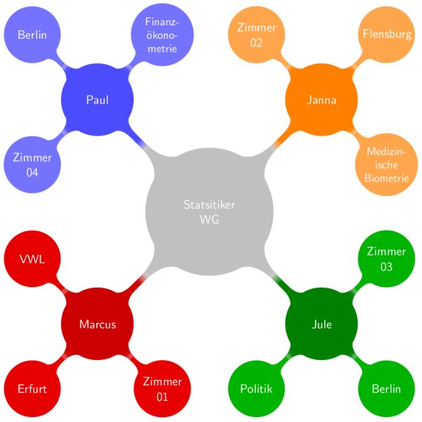
Nciphisa inani lamaqabane akho owabelana nawo ngesondo
Notes:
Okukona unamaqabane amaninzi, okukona unganeqabane eline-HIV. Ukuba iqabane lakho linamaqabane amaninzi, bakhuthaze ukuba balinciphise eli nani kananjalo. Liyakunciphisa umngcipheko wokufumana i-HIV kuni nonke.

Slide 7
Sebenzisa iindlela zokwabelana ngesondo ezinomngcipheko ophantsi
Ukumuncana amalungu angasese kunomngcipheko ophantsi kakhulu kunesondo lekuku okanye lomngxuma welindle.
Abantu abaninzi bacinga ukuba ukwabelana ngesondo ngomngxuma welindle yindlela ekhuselekileyo, kodwa yeyona ndlela inomngcipheko wokwabelana ngesondo yokugqithisa i-HIV.

Slide 8
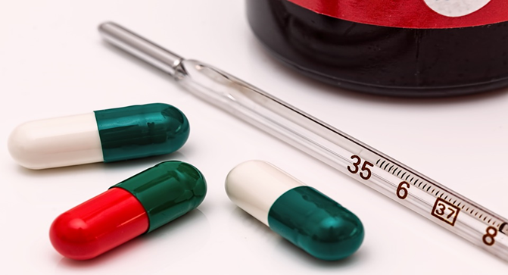
Ukuba unosulelo olufumene ngokwabelana ngesondo (STI), fumana unyango
Ukuba ne-STI kungandisa umngcipheko wakho wokosulelwa yi-HIV okanye uyigqithisele kwabanye.
Nyanzelisa ukuba amaqabane akho avavanywe aze anyangwe nawo.

Slide 9
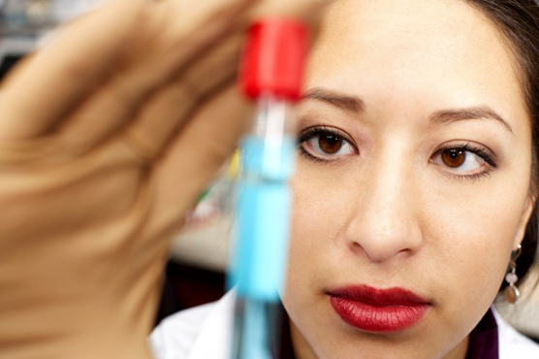
Khuthaza iqabane lakho ukuba livavanyelwe i-HIV
Thetha neqabane lakho ngovavanyo lwe-HIV ze nivavanywe phambi kokuba nabelane ngesondo.
Ukwazi ukuba iqabane lakho line-HIV kunganceda wena ekuthatheni isigqibo sokuba zeziphi iindlela zothintelo ezingasebenza kakhulu kuwe.

Slide 10
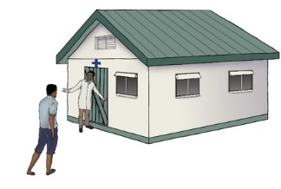
Khuthaza iqabane lakho ukuba loluke
Amadoda olukileyo phantse isiqingatha angafumana i-HIV njengamadoda angolukanga.
Ulwaluko lwamadoda alukhuseli abasetyhini ukuba bangayifumana i-HIV.

Slide 11

Ukuba iqabane lakho line-HIV, likhuthaze ukuba lithobele amayeza alo e-HIV
Notes:
Unyango ngamayeza e-HIV (abizwa itheraphi ngezilwi zintsholongwane okanye i-ART ngamafutshane) kunceda abantu abane-HIV baphile ixesha elide, nobomi obunempilo. I-ART ayinakunyanga usulelo lwe-HIV, kodwa inganciphisa ubungakanani be-HIV emzimbeni wakho. Ukuba ne-HIV encinci emzimbeni wakho kunciphisa umngcipheko wokugqithisela kweqabane lakho i-HIV ngexesha lokwabelana ngesondo.

Slide 12
Nangona zonke iindlela zisenokungenzeki kubo bonke abasetyhini, okukona unokwenza ezi zinto zininzi, okukona unokunciphisa ithuba lakho lokufumana i-HIV.
Ukuba iqabane lakho line-HIV, likhuthaze ukuba lithobele amayeza alo e-HIV

Slide 13

KuLwazi oloNgezelelweyo ngeeKhondom:
Iikhondom zikhusela usulelo lwe-HIV xa kusabelwana ngesondo lekuku nelomngxuma welindle.
Iringi ye-dapivirine inciphisa umngcipheko we-HIV efunyanwa ngokwabelana ngesondo ngomngxuma welindle.
Iringi yayingenzelwanga ukukhusela ukugqithiswa kwe-HIV ngokwabelana ngesondo ngomngxuma welindle kwaye akufanelanga ukuba isetyenziswe kundonci.

Slide 14
KuLwazi oloNgezelelweyo ngeeKhondom:
Iikhondom ziKhusela ukuKhulelwa neZinye i-STIs.
Notes:
Ukongeza ekukhuseleni ukuba ungafumani i-HIV, iikhondom zinezinye iinzuzo zempilo. Abanye abantu abathandanayo bakhetha iikhondom njengendlela yabo yocwangciso-ntsapho yokuthintela ukukhulelwa okungacwangciswanga.

Slide 15
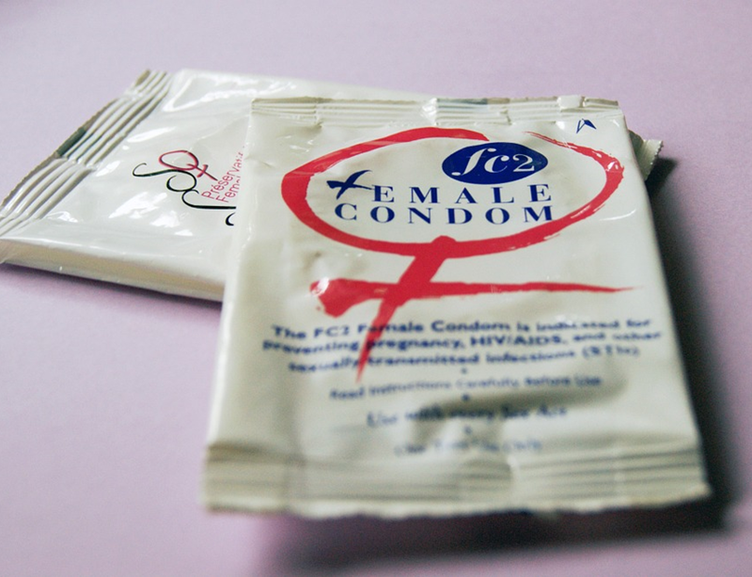

KuLwazi oloNgezelelweyo ngeeKhondom:
Xa isetyenziswa rhoqo nangendlela echanekileyo, iikhondom ze-latex ziyeyona ndlela ingcono yokukhusela i-STIs ezinjengegonoriya, iklamidiya okanye i-trichomonas.
Notes:
Zikwanciphisa umngcipheko wezifo zezilonda ezikumalungu angasese, njenge-genital herpes, igcushuwa nechancroid, xa indawo eyosulelekileyo okanye indawo enethuba lokubasesichengeni ikhuselekile. Zinganciphisa umngcipheko wosulelo lwe-genital human papilomavirus (HPV) nezifo ezayanyaniswe ne-HPV (umz. iintsumpa ezikwilungu langasese nomhlaza wesibeleko).

Slide 16
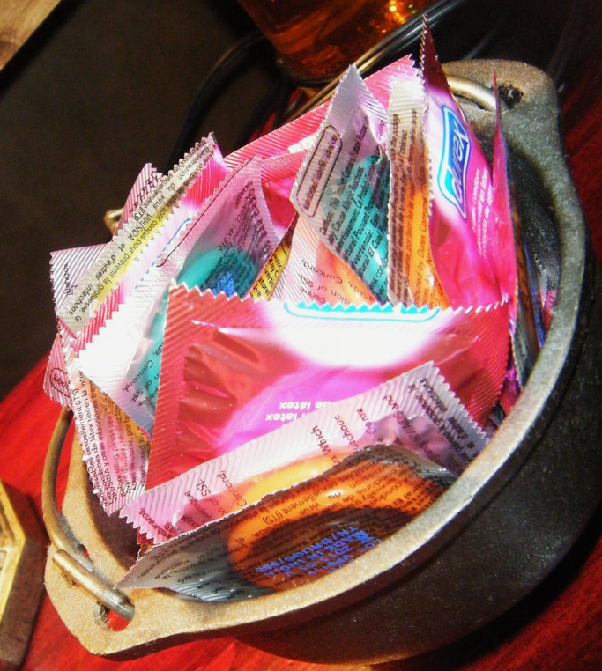
Indlela yokuSebenzisa iiKhondom ngokuChanekileyo naRhoqo
Sebenzisa ikhondom ngesenzo ngasinye sokwabelana ngesondo (ukumcunca ilungu langasese, ukwabelana ngesondo lekuku nangomngxuma welindle).

Slide 17
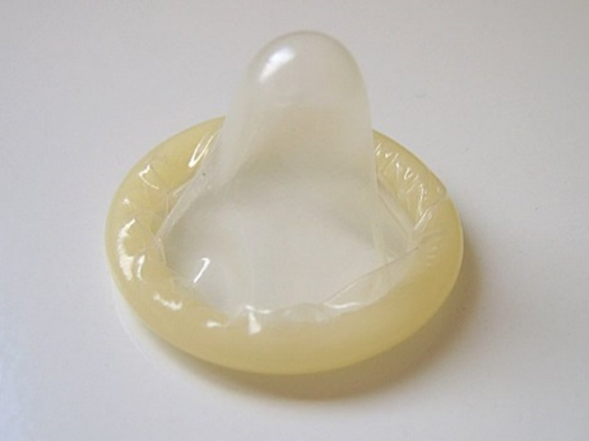
Indlela yokuSebenzisa iiKhondom ngokuChanekileyo naRhoqo
Bamba ikhondom ngononophelo ukuze uphephe ukuyonakalisa ngeenzipho, ngamazinyo, okanye ngezinye izinto ezibukhali.
Faka ikhondom emva kokuba umthondo uthe nkqo naphambi kwakuba uchukumise nalo naliphi na ilungu langasese, ngomlomo okanye ngomngxuma welindle neqabane lakho.

Slide 18

Indlela yokuSebenzisa iiKhondom ngokuChanekileyo naRhoqo
Qinisekisa ukuthambiseka okwaneleyo ngexesha lokwabelana ngesondo lekuku nelomngxuma welindle, kodwa sebenzisa kuphela izithambiso ezinamanzi (njenge-K-Y Jelly) neekhondom ze-latex.
Izithambiso ezine-oli (njenge-Vaseline okanye isithambisi somzimba) ziyakonakalisa iikhondom.

Slide 19
Indlela yokuSebenzisa iiKhondom ngokuChanekileyo naRhoqo
Ukuthintela ikhondom ukuba ingaphuncuki, qinisa ikhondom phaya kumazantsi omthondo xa uyikhupha ze ukhuphe umthondo ngeli xesha usaqinileyo.

Slide 20

Ukuba unemibuzo okanye ufuna ulwazi oluthe vetshe, nceda undwendwele ikliniki yophando.

